Slide 1
Near Field Communication (NFC)
EE174 – SJSU
Tan Nguyen

Slide 2
OBJECTIVES
RFID
NFC
NFC Operations
NFC Applications
NFC Advantages/Disadvantages
Summary

Slide 3
What is RFID?
Radio-Frequency Identification (RFID) is the use of radio waves to read and capture information stored on a tag attached to an object. A tag can be read from up to several feet away and does not need to be within direct line-of-sight of the reader to be tracked.
The RFID device serves the same purpose as a bar code or a magnetic strip on the back of a credit card or ATM card; it provides a unique identifier for that object. And, just as a bar code or magnetic strip must be scanned to get the information, the RFID device must be scanned to retrieve the identifying information.
RFID mostly use frequency ranges:
LF: 125-134KHz
HF: 13.56MHz
UHF: 433MHz, and 860-915MHz

Slide 4
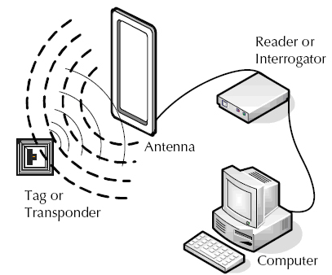
How RFID Works
A RFID system consists of:
A tag or label.
A reader.
Ant
RFID tags or labels are embedded with a transmitter and a receiver.
The RFID component on the tags have two parts: a microchip that stores and processes information, and an antenna to receive and transmit a signal. The tag contains the specific serial number for one specific object.
To read the information encoded on a tag, a two-way radio transmitter-receiver (called an interrogator/reader emits a radio-frequency signal in a relatively short range to the tag using an antenna. In case of passive RFID tag, the RF radiation also provides the energy to the passive RFID tag to communicate.
The tag responds with the information written in its memory bank. The interrogator will then transmit the read results to an RFID computer program.

Slide 5
Passive RFID Tag
There are two types of RFID tags:
Passive or non-battery powered RFID tag
Active or battery powered RFID tag
A passive RFID tag that does not contain a battery will use the interrogator’s radio wave energy to relay its stored information back to the interrogator.
Disadvantages of a passive RFID tag:
Can be read only at very short distances, typically a few feet at most. This greatly limits many applications.
It may not be possible to include sensors that can use electricity for power.
Advantages of a passive RFID tag:
Functions without a battery and have a useful life of twenty years +.
Less expensive to manufacture
Much smaller (size of a grain of rice). These tags have almost unlimited applications in consumer goods and other areas.
An active RFID tag is equipped with a battery that can be used as a partial or complete source of power for the tag's circuitry and antenna. Some active tags contain replaceable batteries for years of use; others are sealed units.
Disadvantages of an active RFID tag:
Cannot function without battery power, which limits the lifetime of the tag.
Typically more expensive.
Is physically larger, which may limit applications.
Higher cost for maintenance if the batteries are replaced.
Battery outages can result in expensive misreads.
Advantages of an active RFID tag:
Can be read at distances of one hundred feet or more, greatly improving the utility of the device.
May have other sensors that can use electricity for power.

Slide 6
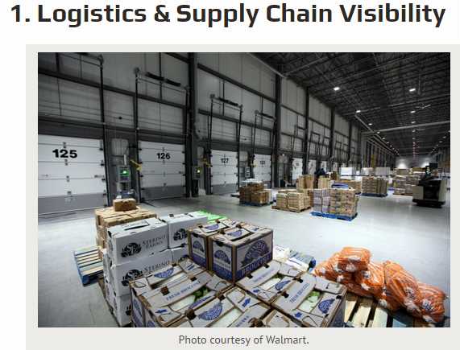
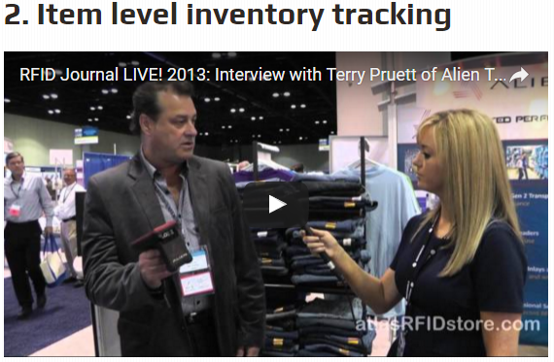
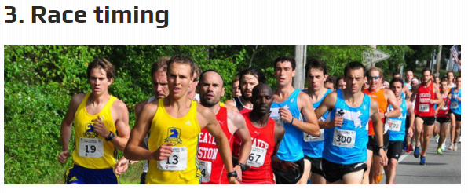
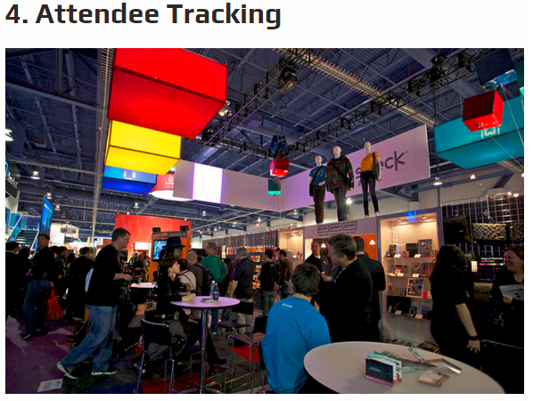
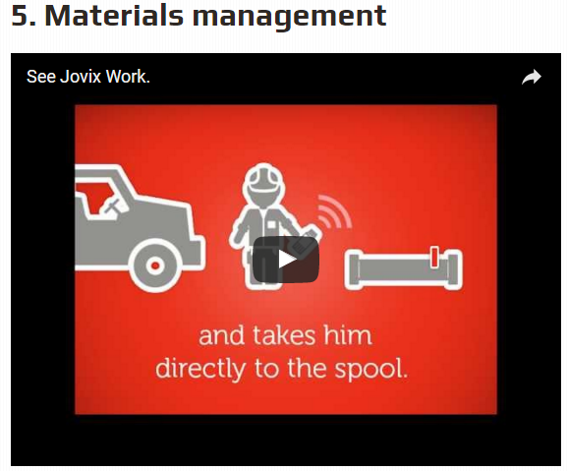
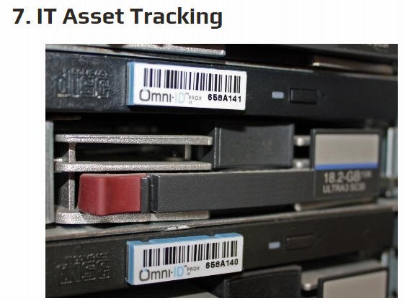
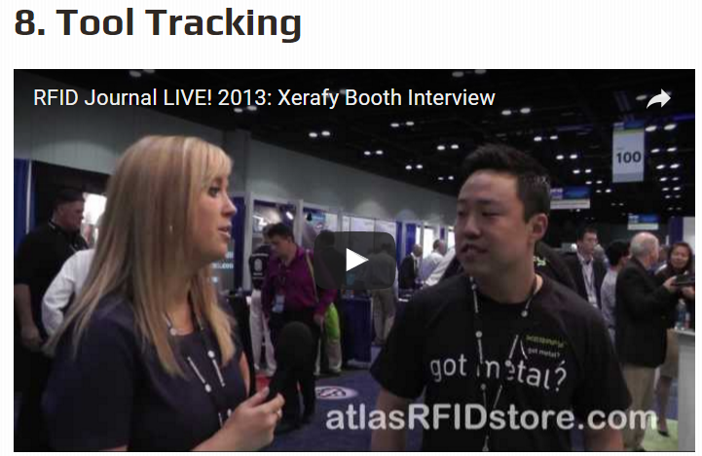
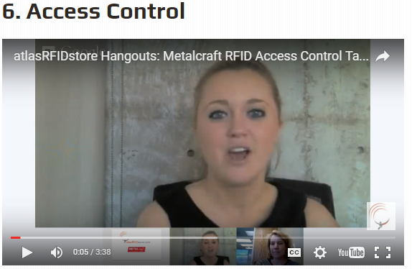
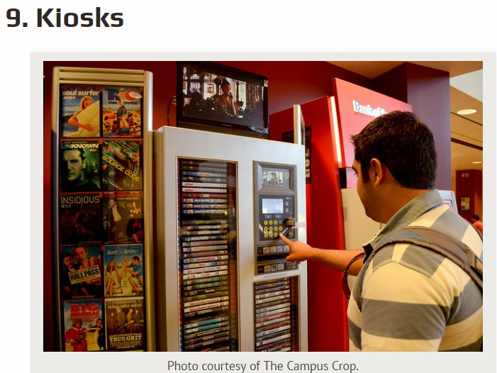
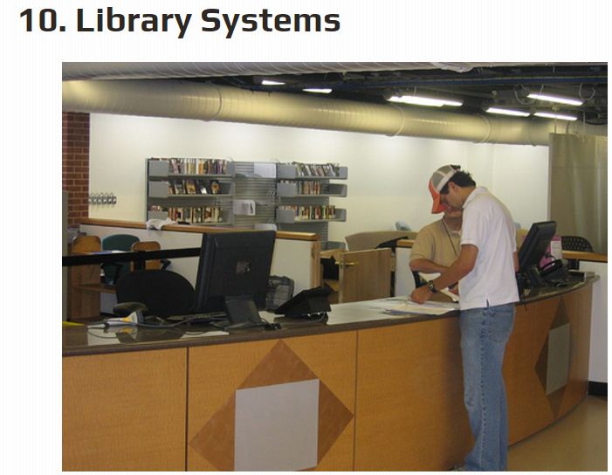
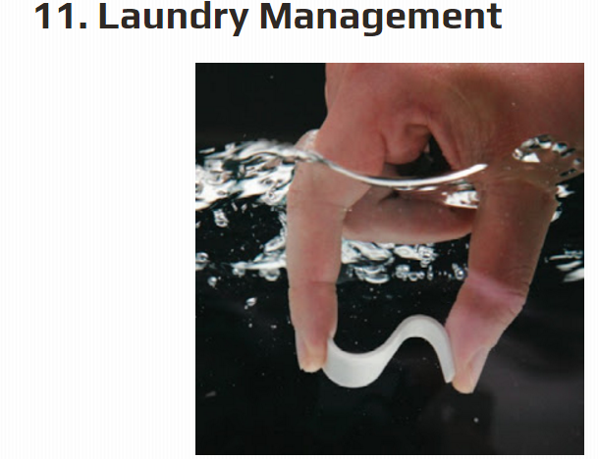
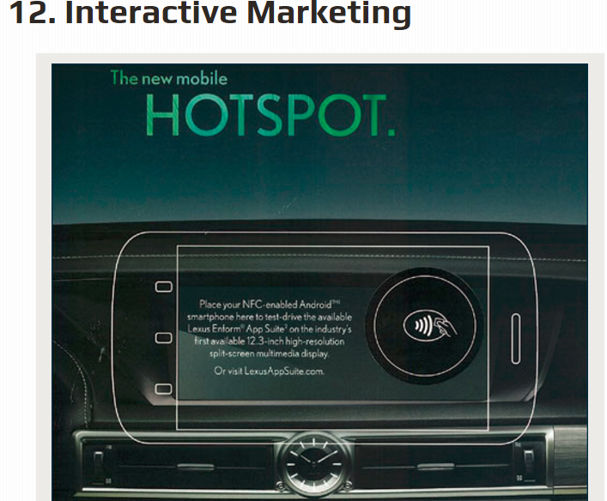
http://blog.atlasrfidstore.com/what-is-rfid-used-for-in-applications

Slide 7
What is NFC?
NFC is an offshoot of RFID with the exception that NFC is designed for use by devices within close proximity to each other.
NFC is a short range high frequency wireless technology that carry secure two-way interactions between electronic devices.
NFC utilizes electromagnetic radio fields while technologies such as Bluetooth and Wi-Fi focus on radio transmissions instead.
NFC provides contact or contactless communication in a proximity of 1 – 4 centimeters and up to 10 centimeters.
NFC is mainly aimed for mobile or handheld devices.
NFC allows communication between:
Two powered (active) devices
Powered and non self-powered (passive) devices.
NFC offers the ultimate in security and convenience, and makes new interactions possible.
NFC combines the interface of a smartcard and a reader into a single device that allows two-way communication between endpoints, where RFID system was one-way only.
NFC devices operate at 13.56MHz, with a bandwidth 14kHz.
NFC supports data rates: 106, 212 and 424 Kbits/s
For two devices to communicate using NFC, one device must have an NFC reader/writer and one must have an NFC Tag.

Slide 8
NFC Time Line
Year | Event
1983 | The first patent to be associated with RFID was granted to Charles Walton
2002 | NXP Semiconductors and Sony co-invent NFC
2004 | Nokia, Phillips and Sony established the NFC forum
2006 | Initial specifications for NFC Forum Tags and “Smart Poster” records
2006 | Nokia launches the first NFC phone (Nokia 6131)
2009 | NFC Forum releases Peer-to-Peer standards
2010 | Samsung, Nexus 5: First Android NFC phone shown
2010 | AT&T, Verizon, T-Mobile announces Softcard mobile payment joint venture
2011 | Google I/O “How to NFC” demonstrates NFC to initiates a game and to share a contact, URL, app, video, …
2011 | RIM is 1st company for its devices is certified by Mastercard worldwide, the functionality of PayPass
2012 | Samsung introduces TecTile, a set of NFC stickers and a companion App for Android to read/write TecTile
2012 | Sony introduces “Smart Tags” using NFC technology to chab=nge modes and profiles on Sony smart phone
2012 | Wired US is the 1st mass market publication to feature NFC enable advertisements
2013 | Samsung and Vise announces major partnership to develop mobile payments
2014 | Apple introduces iPhone 6 with Apple Pay using NFC Tecnology

Slide 9
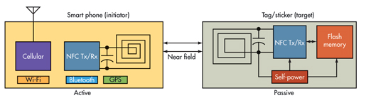
Active and Passive NFC Devices
Active NFC device usually a microcontroller based like a NFC enabled smartphone, would not only be able to collect information from NFC tags, but it would also be able to exchange information with other compatible phones or devices and could even alter the information on the NFC tag if authorized to make such changes.
NFC reader continuously emits RF carrier signals and keeps observing the received RF signals for data.
A passive device, such as an NFC tag, contains information that other devices can read but does not read any information itself. NFC tag does not have its own power source. It absorbs energy emitted by the reader(phone) and starts sending modulated information when sufficient energy is acquired from the RF field generated by the reader. Data modulation (0s and 1s) is accomplished by either direct modulation or FSK or Phase modulation.
Operation: Active device generates the RF field and the passive device uses the field to power itself and communicate.

Slide 10
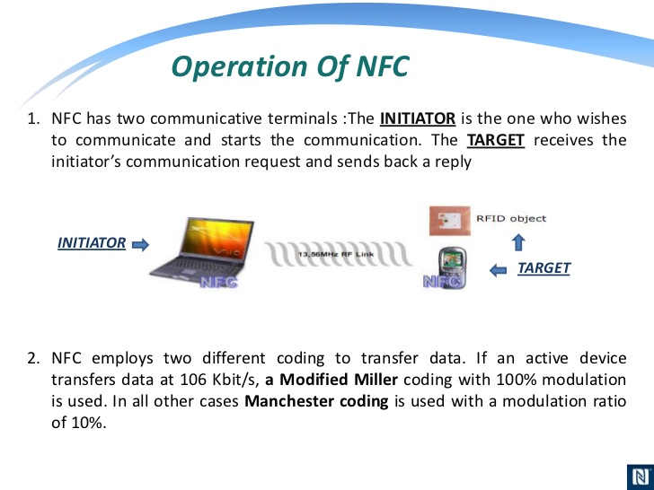
10% ASK modulation means ASK modulation in which modulation index will range between 8% and 14%.
In 100% ASK modulation, unmodulated signal amplitude and modulated signal amplitude is almost equal.

Slide 11
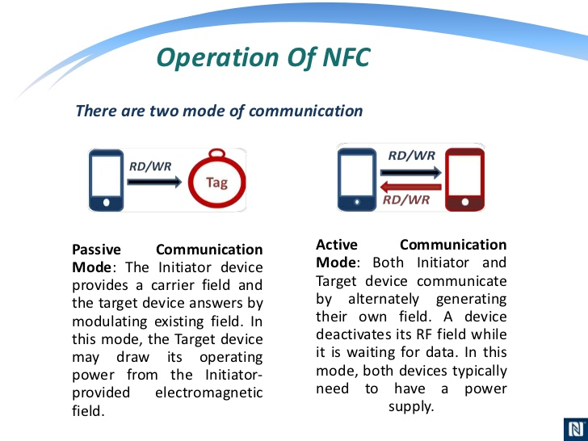

Slide 12
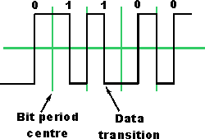
NFC and Manchester coding
Manchester coding is used for the majority of cases for the NFC communications. The Manchester coding utilises the two different transitions that may occur at the midpoint of a period. A low-to-high transition expresses a 0 bit, whereas a high-to-low transition stands for a 1 bit.
Manchester coding used for NFC data transfer

Slide 13
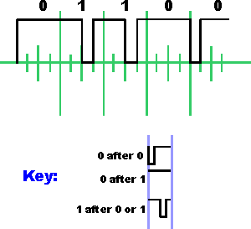
NFC and Modified Miller coding
Depending on the information to be transmitted, bits are coded as shown below. A high or "1" is always encoded inth e same way, but a low or "0" is encoded differently dependent upon what preceded it.
Modified Miller coding used for NFC data transfer used for 106 kbps active device transfers

Slide 14
NFC RF signal coding
NFC employs two different coding systems on the RF signal to transfer data. In most cases a level of 10% modulation is used, with a Manchester coding format. However for an active device transmitting data at 106 kbps, a modified Miller coding scheme is used with 100% modulation. In all other cases Manchester coding is used with a modulation ratio of 10%.
DATA RATE KBPS | ACTIVE DEVICE | PASSIVE DEVICE
106 | Modified Miller, 100%, ASK | Manchester, 10%, ASK
212 | Manchester, 10%, ASK | Manchester, 10%, ASK
424 | Manchester, 10%, ASK | Manchester, 10%, ASK

Slide 15
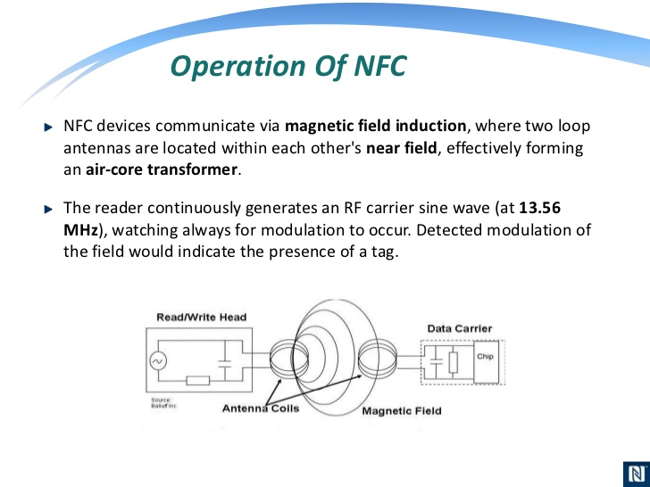

Slide 16
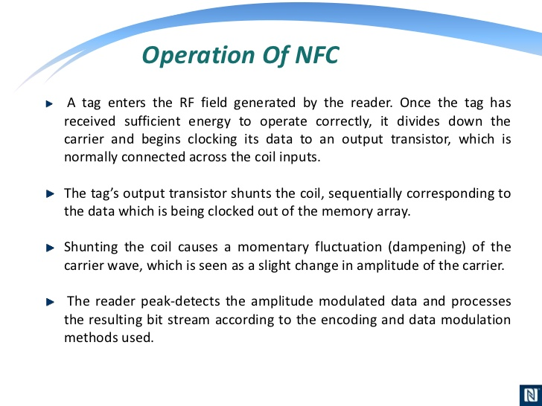

Slide 17
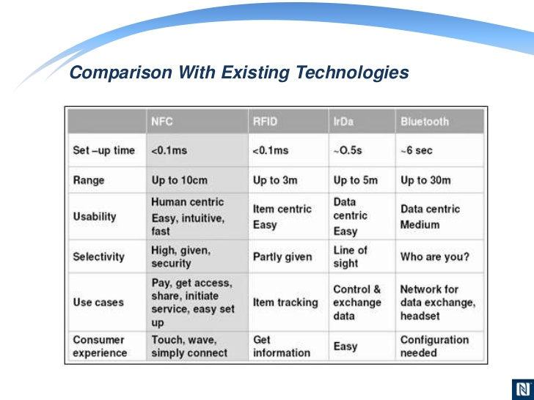

Slide 18
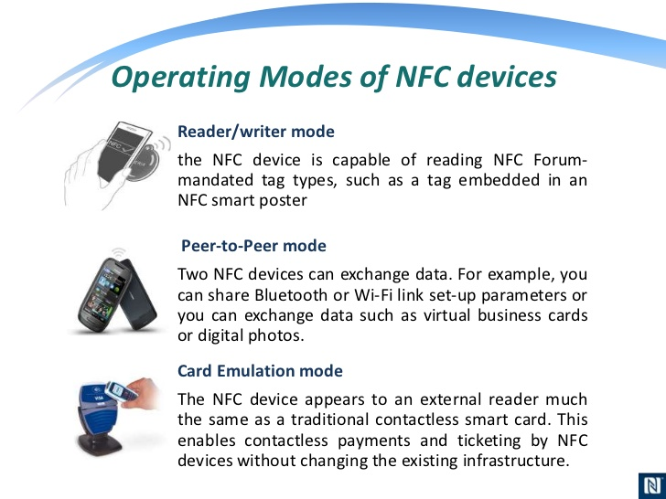

Slide 19
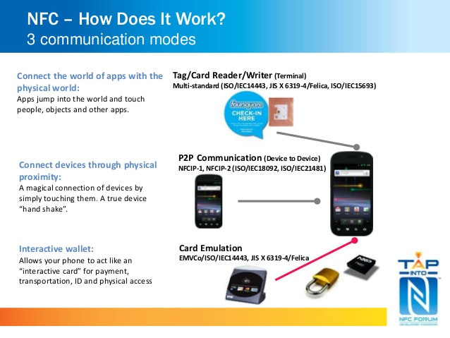

Slide 20
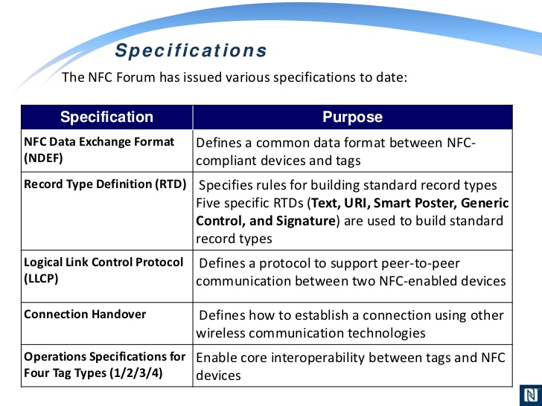

Slide 21
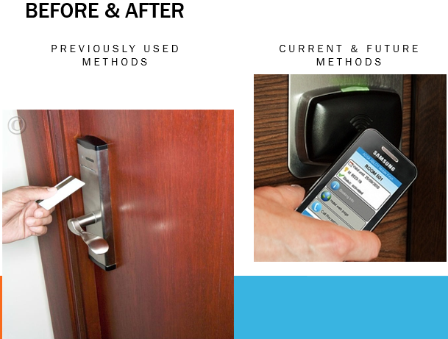

Slide 22
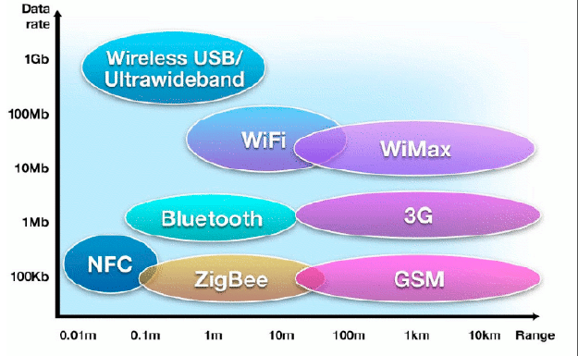
DATA RATE & RANGE

Slide 23
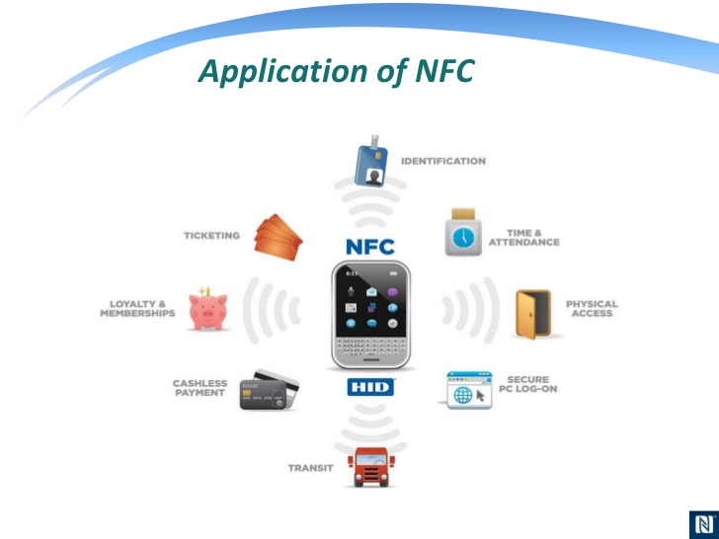

Slide 24
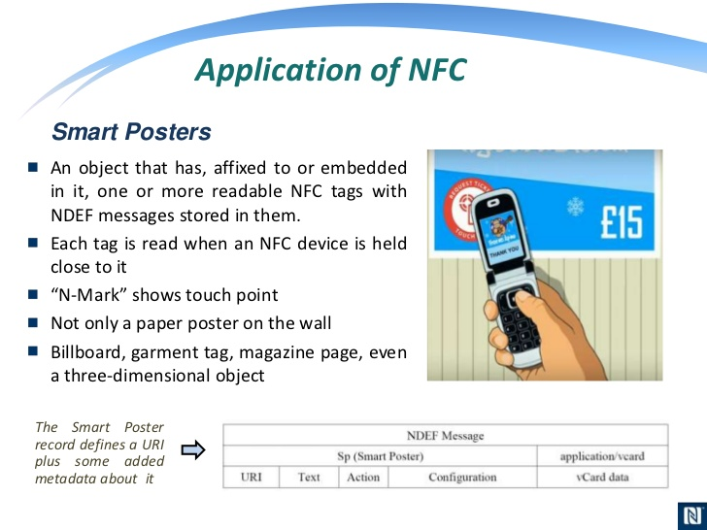

Slide 25
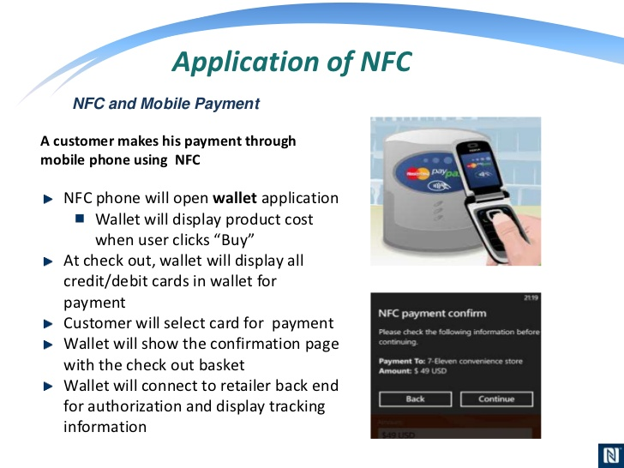

Slide 26
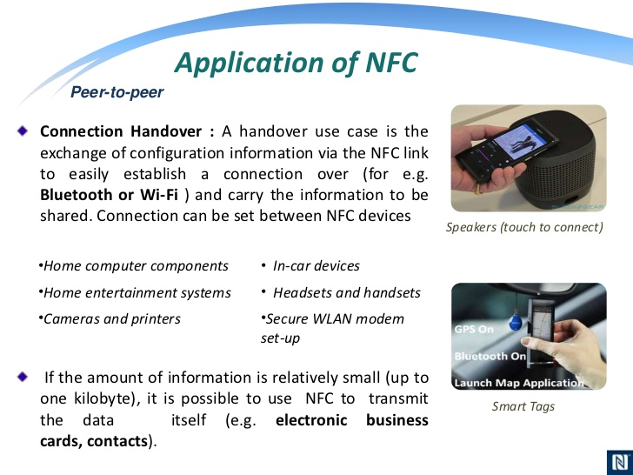

Slide 27
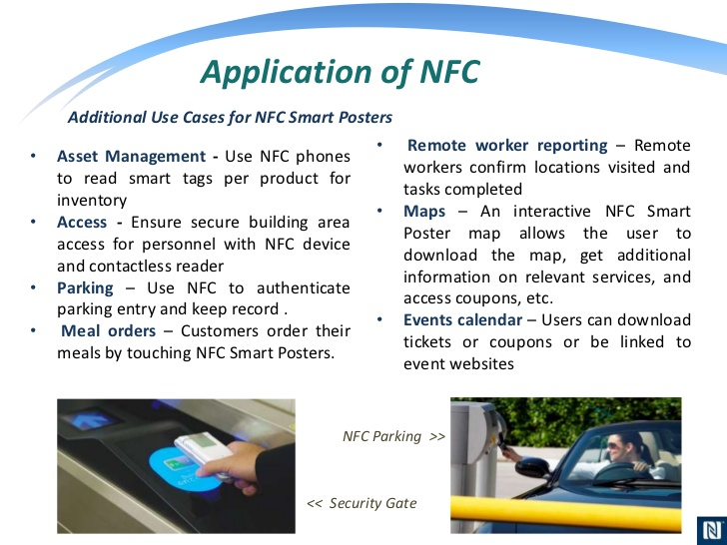

Slide 28
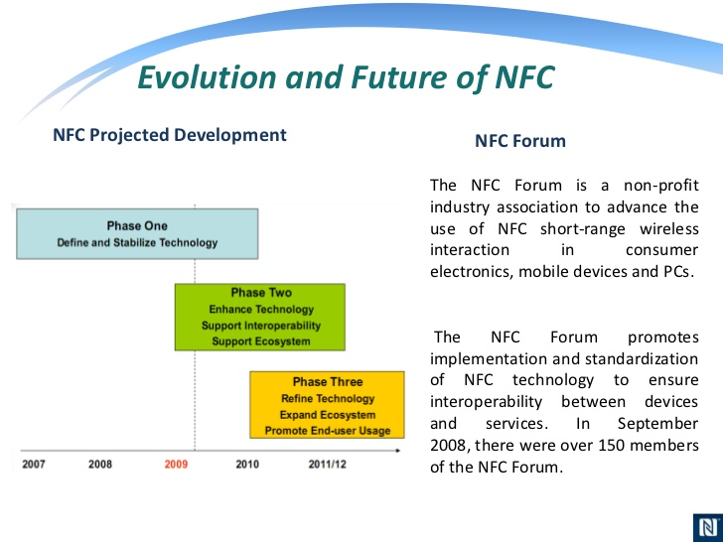

Slide 29
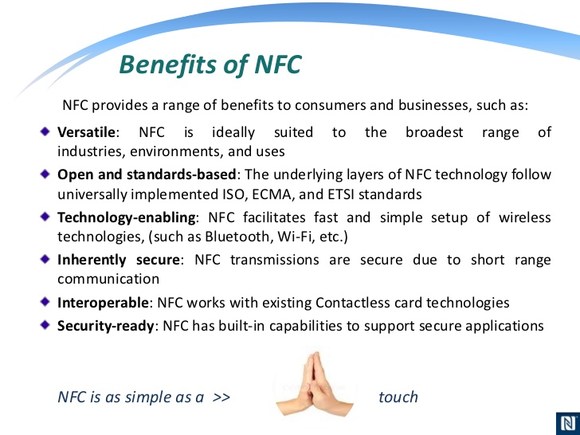

Slide 30
Advantages of NFC
Convenience: Many consumers will "pay" for convenience because convenience is very important in today's society. NFC is a perfect source of convenience because it merges a mobile device with wallet(s). NFC is also quite intuitive; all it takes is a simple touch when using NFC for payments. Can you imagine how much faster line ups would be at the grocery store, coffee shop, etc?
2. Versatility: NFC can be well adapted for all kinds of situations ranging from bank cards to transit passes, movie passes, reward systems and even keys. Ideally, NFC is suited for a broad range of industries and uses because this innovation allows users to manipulate through the development of software.
3. Safety: Now, you might think how could fusing your wallet into your mobile device be safer. After all, just like a wallet, a cellphone could be stolen. However when your wallet is stolen, the thief has access to all your credit cards and information right away! With smartphones, passwords can be used to further protect your information.
NFC enabled credit cards are much more secure than a credit card magnetic strip
Requires PIN
Retailers no longer have physical access to your credit card information

Slide 31
Disadvantages of NFC
1. Company Agreements to use NFC: Many of us who would like to try out NFC wishes that it can be used everywhere and anywhere. However if companies do not agree to integrate NFC into their business, consumers will not be able to use the technology.
2. Security:
Another major risk to NFC is computer hacking or phone hacking. As mobile phones become more developed, they become much like a hand held computer, and as with computers, they become prone to viruses. Hackers will want to gain access to these tiny computers because it contains a lot of important information all in one device.
Examples include a phone’s owner credit card information, bill payments, social security information, etc. Moreover, as technology advances, it will becomes easier for hackers to do this.
3. Limitations: NFC can be operated under short range (< 10 cm) with data rate is very less at about 106, 212 and 424kbps.

Slide 32
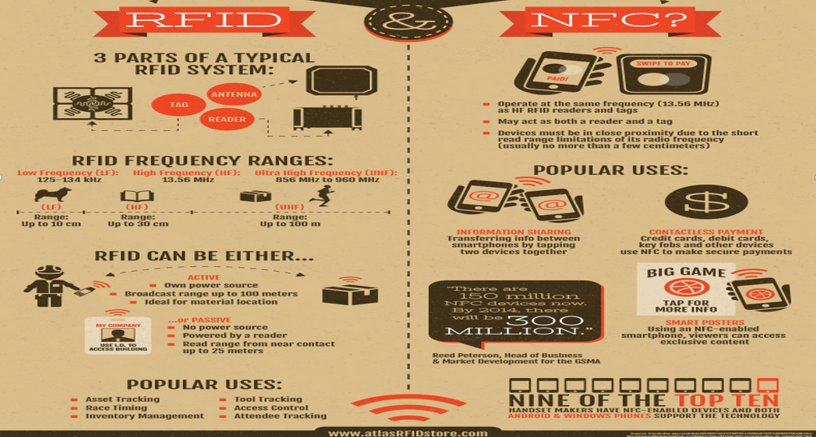
RFID vs. NFC: What’s the Difference?

Slide 33
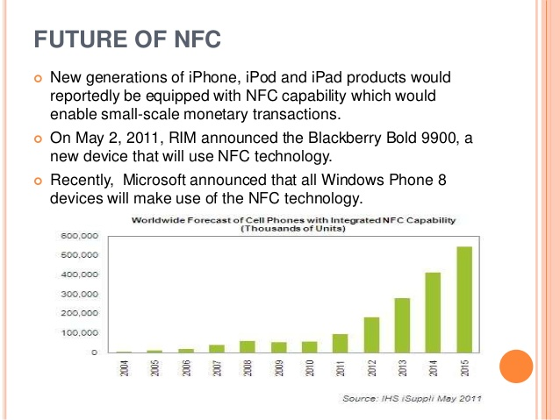

Slide 34
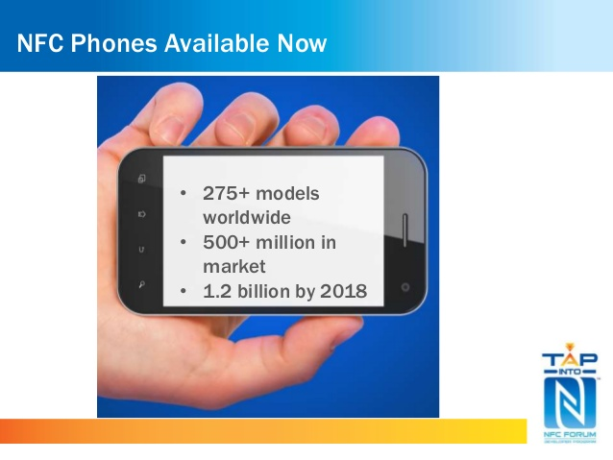

Slide 35
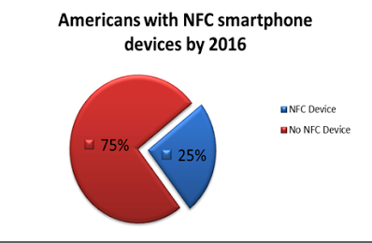

Slide 36
Conclusion
Mobile handsets are primary target for NFC and soon NFC will be implemented in most handheld devices. Even though NFC has the shortest range among radio frequency technologies, but it is revolutionary due to its security, compatibility, user friendly interface, immense applications, etc.
The advancements in mobile wireless technology and communication standards have enabled usage of contactless and NFC based payment models.
The mobile wallet based payment model is gaining considerable momentum and is currently being seen as one of the key payment model, to promote contactless payment processing practices.
The mobile wallet technology enables the end-users to make payments with their mobile wallet accounts, without having to use credit or debit cards and hence this technology can also help users that do not use credit or debit cards.

Slide 37
References:
http://www.epc-rfid.info/rfid
http://www.technovelgy.com/ct/technology-article.asp
http://www.webopedia.com/TERM/R/RFID.html
http://www.technovelgy.com/ct/Technology-Article.asp?ArtNum=2
http://wnss.sv.cmu.edu/courses/14829/f11/files/CMU_NFC_Overview_11072011.pdf
http://www.radio-electronics.com/info/wireless/nfc/near-field-communications-tutorial.php
http://www.radio-electronics.com/info/wireless/nfc/nfc-near-field-communications-technology.php
http://www.radio-electronics.com/info/wireless/nfc/near-field-communications-modulation-rf-signal-interface.php
http://electronicdesign.com/communications/fundamentals-short-range-wireless-technology
http://education-portal.com/academy/lesson/short-range-wireless-communication-bluetooth-zigbee-infrared-transmission.html#lesson
http://www.nxp.com/techzones/nfc-zone/overview.html
http://www.nxp.com/techzones/nfc-zone/news.html
http://www.nearfieldcommunication.org/how-it-works.html
http://www.slideshare.net/akshatrohatgi/nfc-technical-presentation?related=1

Slide 38
http://www.slideshare.net/NFC-Forum/nfc-in-action-conference?qid=1fd0de69-a16e-4c94-9b17-699bcecc74ff&v=qf1&b=&from_search=12
http://www.slideshare.net/NehaSingh145/nfc-technology-27491511?qid=2b587069-0fd9-4c1f-ad64-ba20c37de4cc&v=default&b=&from_search=2
http://near-field.blogspot.com/p/pros-cons.html

